Slide 1
Total Quality Control for Insect Rearing
Norm Leppla
University of Florida
Entomology and Nematology Department
Workshop on Breeding and Quality Control of Entomophagous Insects and Entomopathogenic Fungi
Merida, Mexico
November 14 – 17, 2017

Slide 2
Norm’s Career in Insect Rearing
University of Arizona- Insect rearing research, 2 years (pink bollworm, noctuids)
USDA, ARS- Insectary management, Florida and Texas, 17 years (noctuids, fruit flies, screwworm, parasitoids)
USDA, APHIS- Methods development, Washington DC and international, 7 years (gypsy moth, PBW, FF)
University of Florida- Integrated pest management and biological control, 20 years
Rearing and quality of Tamarixia radiata (Chris Kerr)
Quality of Trichogramma brassicae from Ephestia kuehniella eggs (Yasaman Moghaddassi)

Slide 3
Quality Control Topics
Learning how to rear quality insects
Colony Establishment and Maintenance
Monitoring Insect Quality

Slide 4
Learning How to Rear High Quality Insects
Apprentice in an insectary
Network with other professionals
Publications plus trial and error
Videos
Visit other insectaries
Reviews by experts
Education and training programs

Slide 5
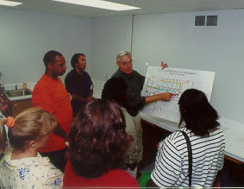
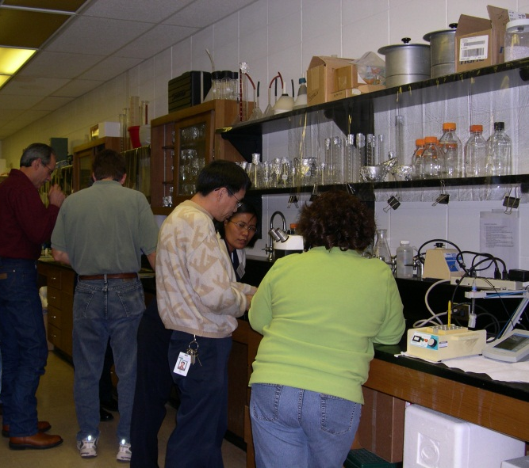
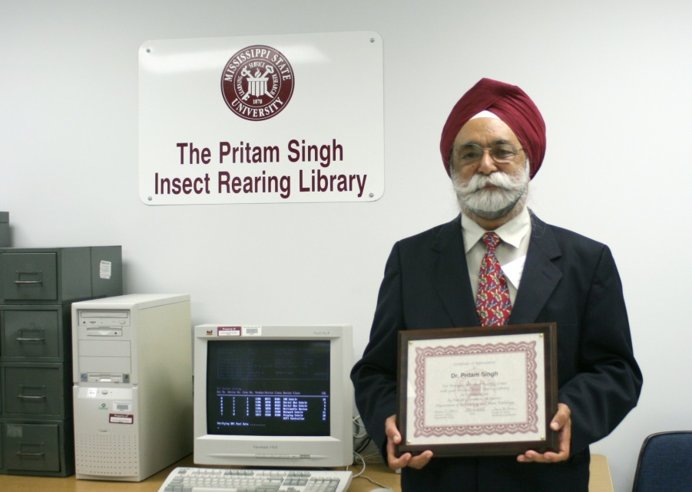
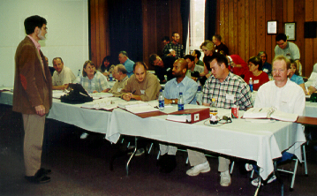
MSU Insect Rearing Center
Frank Davis
John Schneider

Slide 6
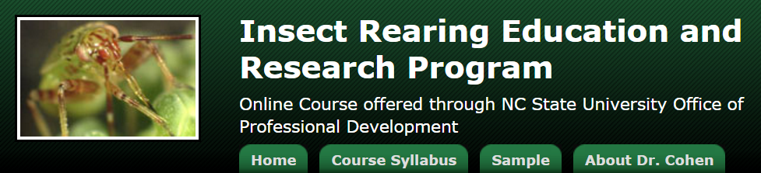

Allen Cohen
Online courses
Classroom courses
Webinars
Mentoring
https://www.ncsu.edu/mckimmon/cpe/opd/insectRearing/index.html

Slide 7
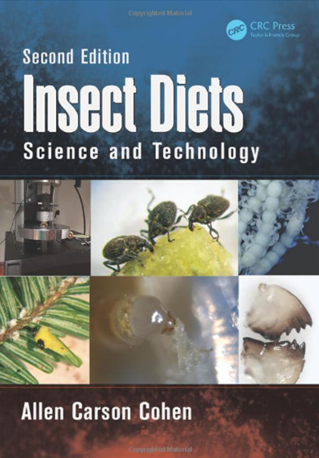

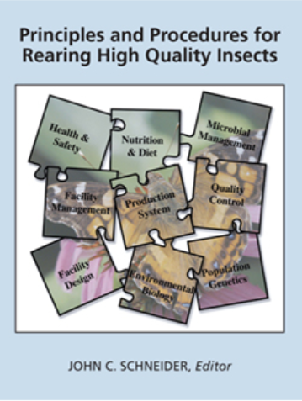
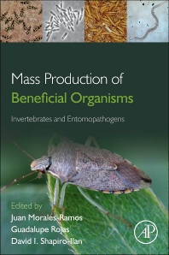
Publications
Cohen 2015
Van Lenteren 2009
Schneider 2009
IOBC, MRQA Guidelines and Proceedings
www.amrqc.org
Morales-Ramos
et al. 2013

Slide 8

Insect Rearing Professionals
Google Group
Subscribe:
(leonwesterd@gmail.com)
Léon Westerd
Group moderator
Head of insect rearing
Wageningen UR, Netherlands

Slide 9
II. Colony Establishment and
Maintenance
Purposes for Rearing Insects
Types of Insect Rearing Systems
Options for Colonizing Insects
Maintaining the Quality of Colonized Insects

Slide 10
Purposes for Rearing Insects
Red Palm Weevil
Hoddle 2015

Slide 11
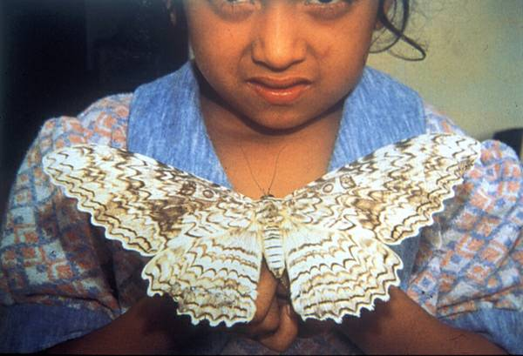
White witch, Thysania agrippina (Lepidoptera: Noctuidae

Slide 12
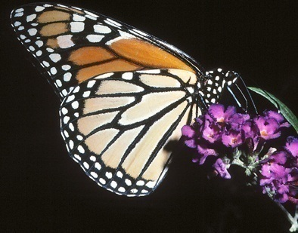

Small-Scale Rearing: Butterflies
Types of Insect Rearing Systems
Monarch
Painted Lady

Slide 13
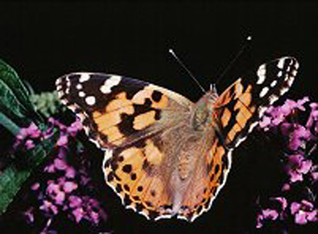
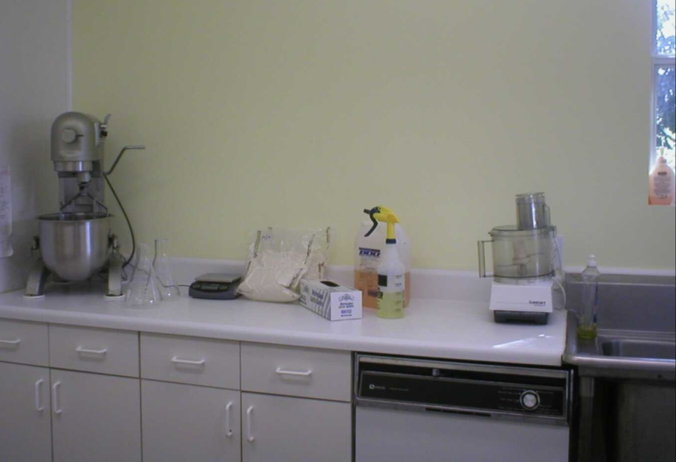
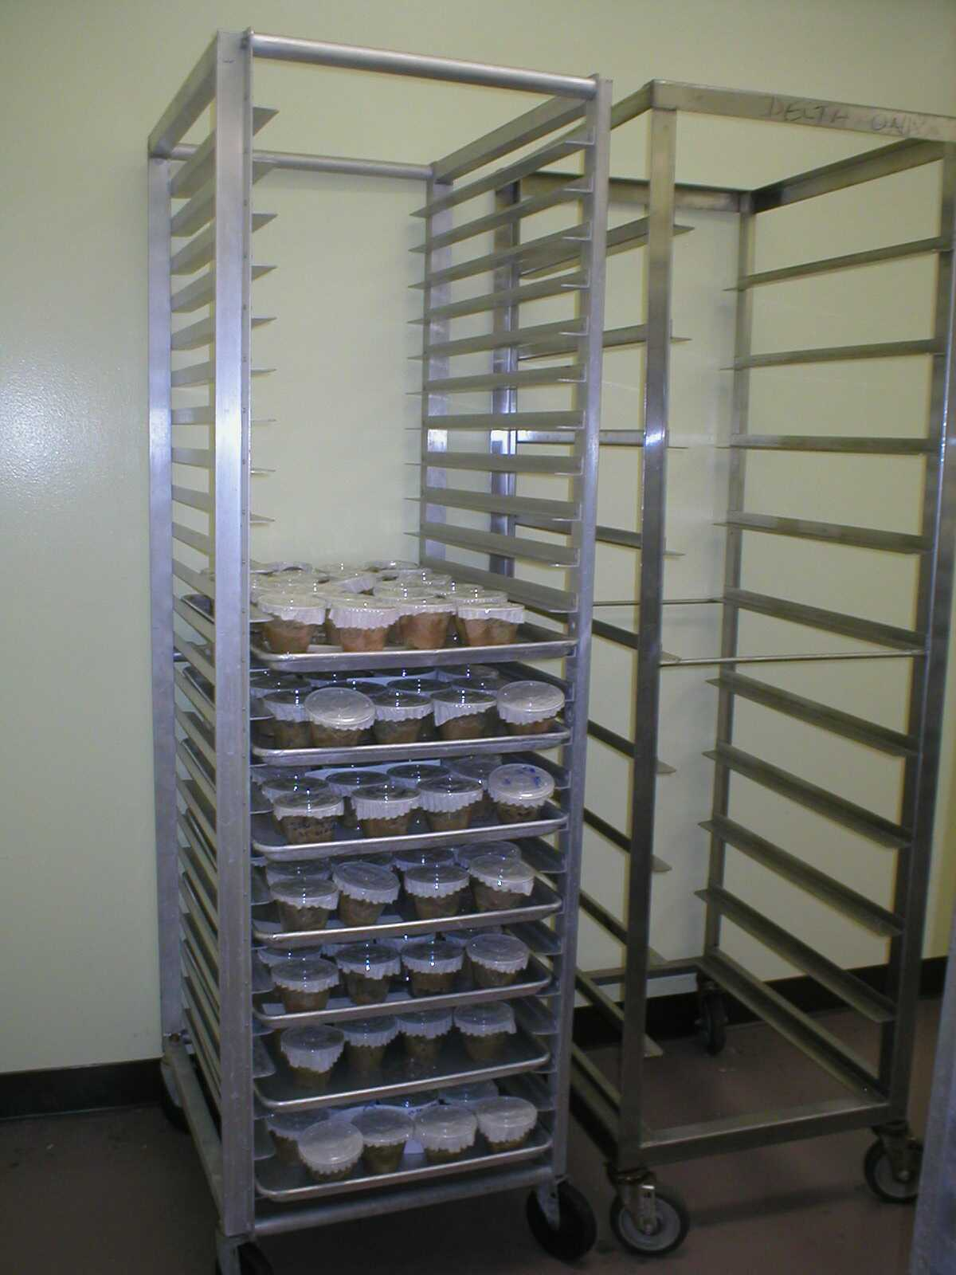
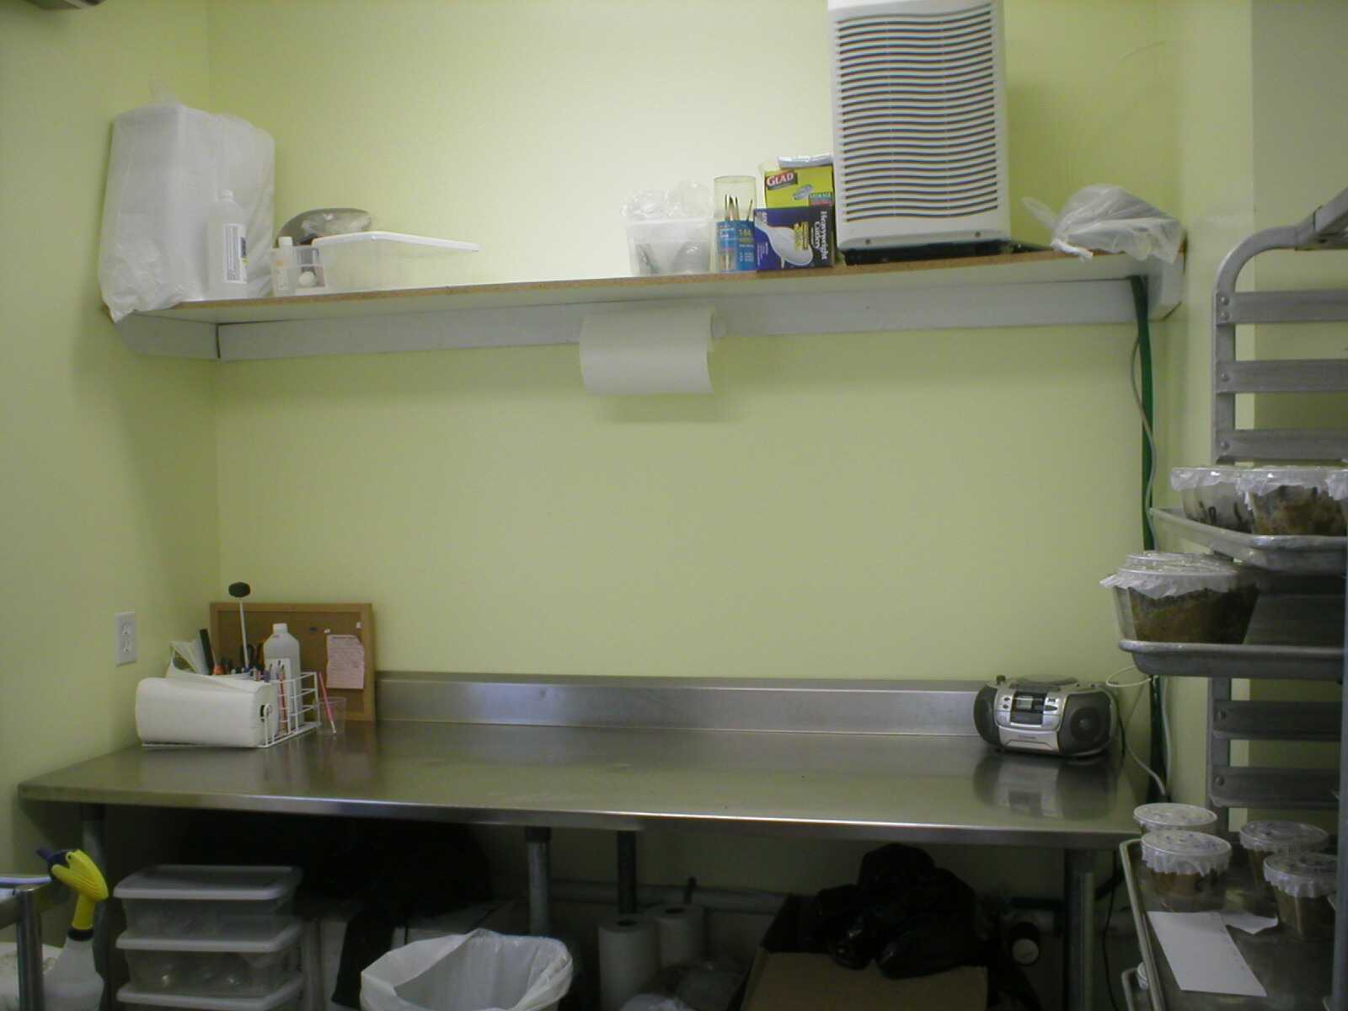
Individual Rearing

Slide 14
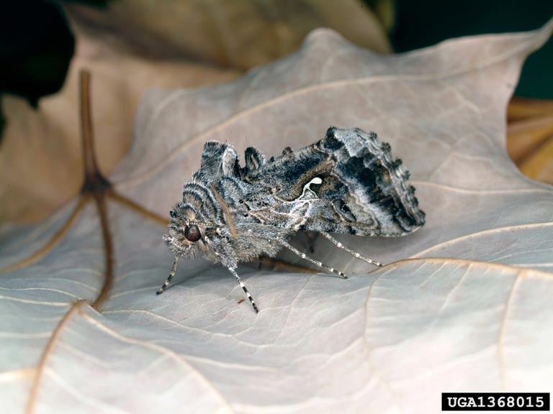
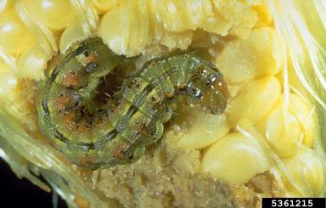
Medium-Scale Rearing:
Lepidoptera
Cabbage Looper, Trichoplusia ni
Corn Earworm, Helicoverpa zea

Slide 15

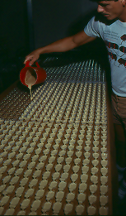
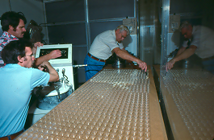
Small Group Rearing
Keith Halein
Clarence Green
Jack Rye
Bill Fisher

Slide 16
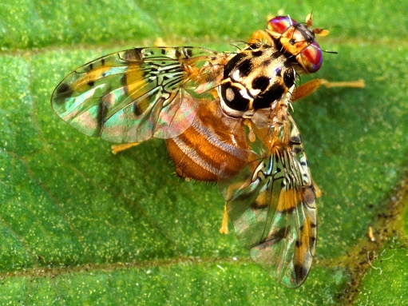
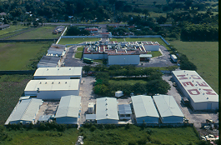
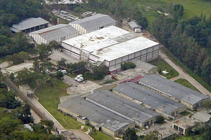
Mass Rearing- Medfly
Metapa, Mexico
El Pino, Guatemala
Capacity- 3.5 billion sterile
male pupae per week
Scott Bauer

Slide 17
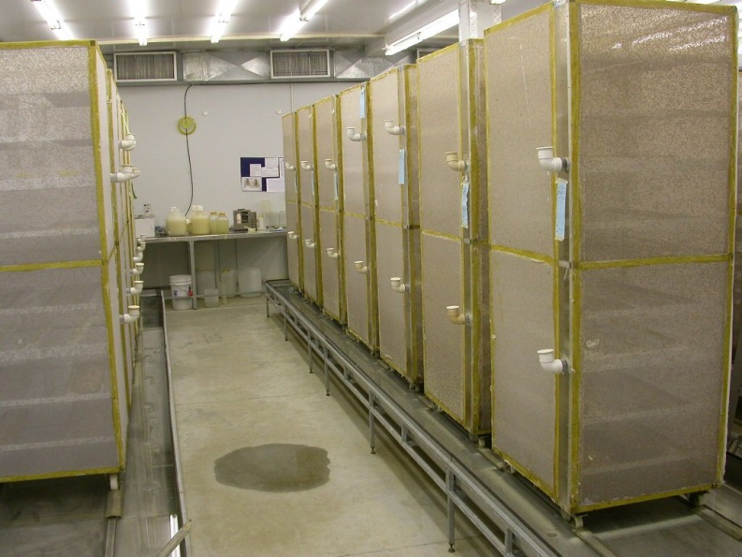
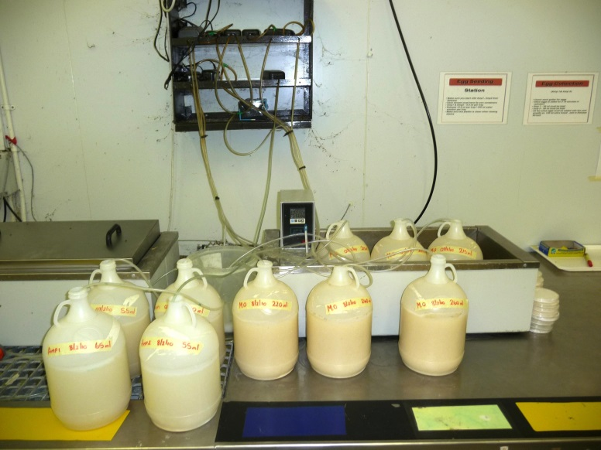
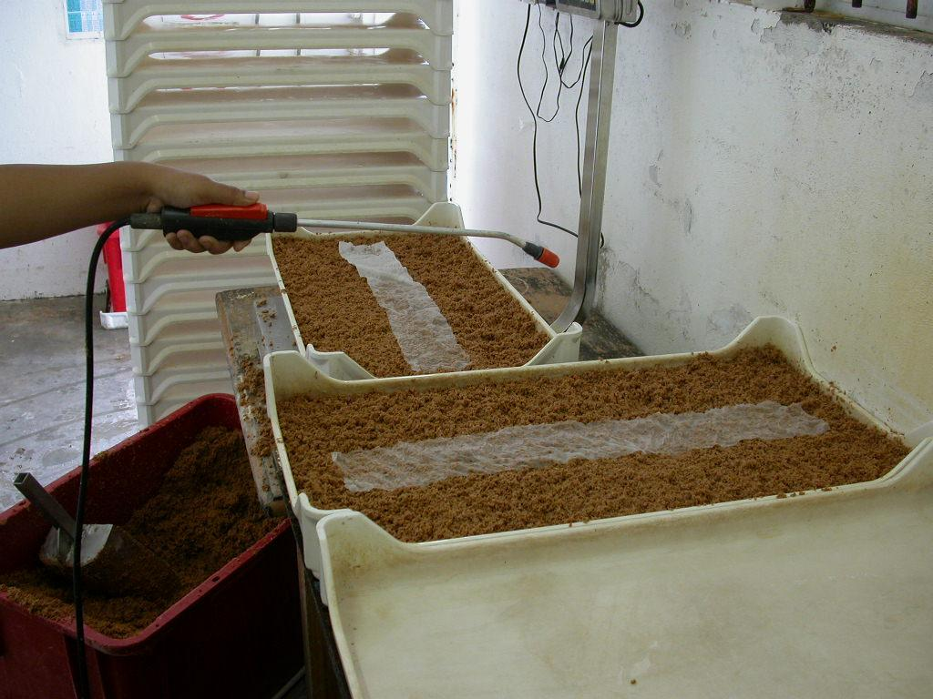
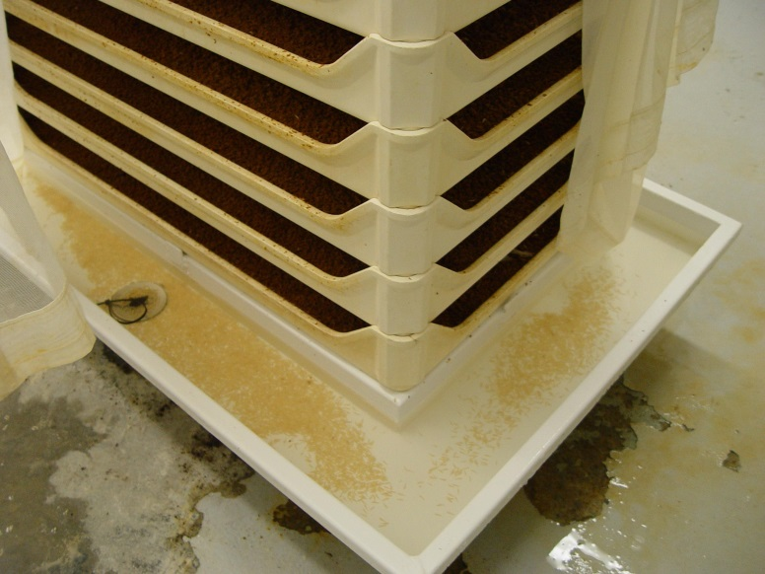
Mass Rearing- Medfly

Slide 18
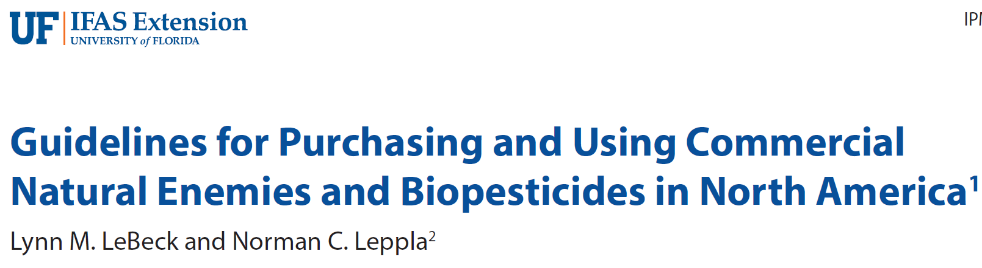


Options for Colonizing Insects
Obtain appropriate biotypes
http://edis.ifas.ufl.edu
Insect Rearing Professionals
Google Group

Slide 19
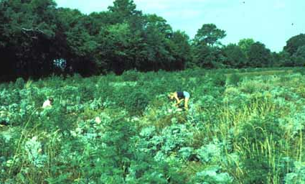
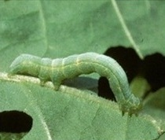
Field Collecting
Cabbage Loopers
Trichoplusia ni

Slide 20
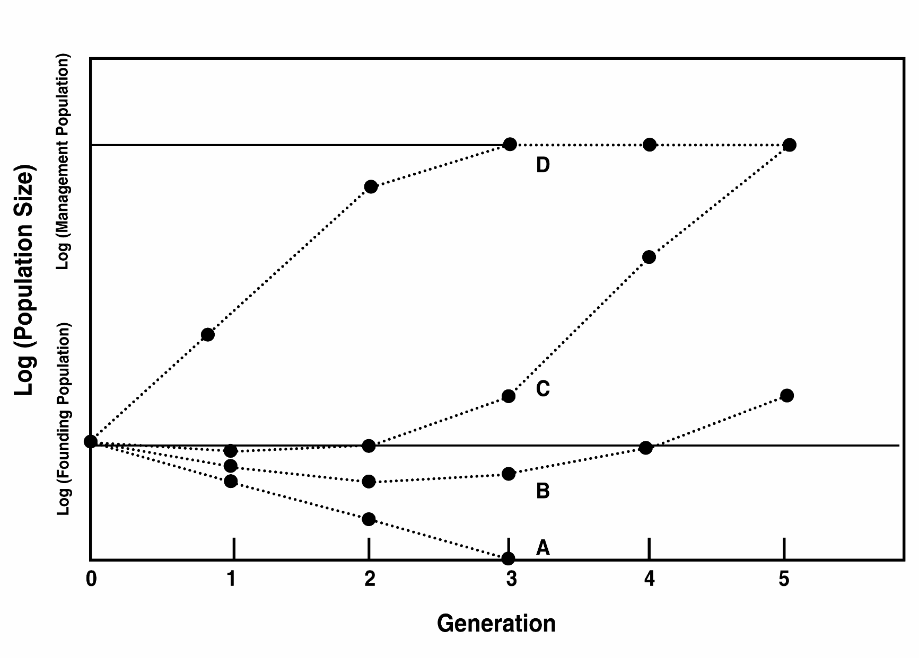
Continuous Improvement in Establishing Colonies

Slide 21
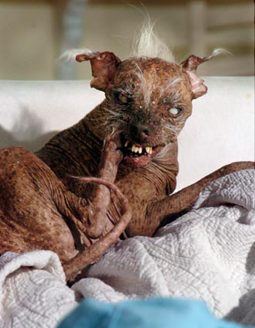
Maintaining the Quality of Colonized Insects
Consistent procedures (SOPs)
Diagnose problems
Strain modification
Sam 2005

Slide 22
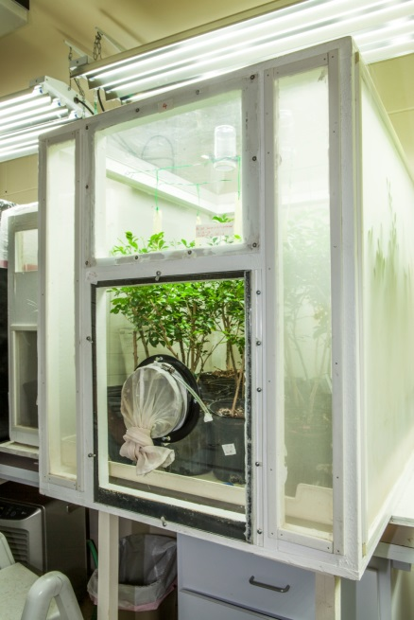
Mass-Rearing Tamarixia radiata: Standard Operating Procedures
Purpose
I. Facilities and Equipment
II. Orange Jasmine Care
III. Asian Citrus Psyllid Rearing
IV. Tamarixia radiata Rearing
V. Storage and Shipment Appendix (A) Pest Identification
Appendix (B) Sample Log Worksheets
Chris Kerr

Slide 23
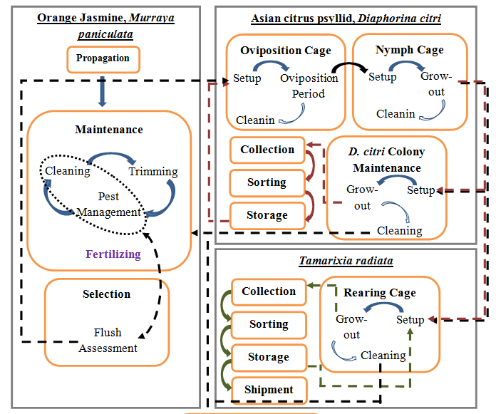
Tritrophic Rearing System Tamarixia radiata SOPs
Chris Kerr

Slide 24
Mass Rearing System for Trichogramma maidis
Field collect target area
Release colony
Reared 1-3 gen.
Lab insectary
Constant temperature, RH
Factitious host
No plants
Continuous colony
Field Insectary
Fluctuating temperature, RH
ECB host
Corn plants 3-4 meters to fly
Stored, diapause, months
Release parasitized eggs, target area

Slide 25
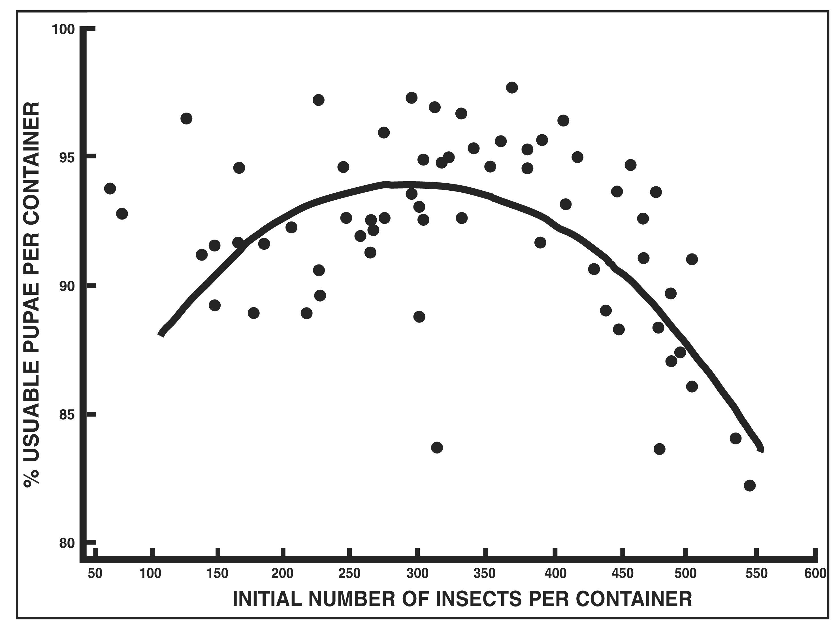
Maintaining Insect Density: Fall Armyworm
Bill Fisher

Slide 26
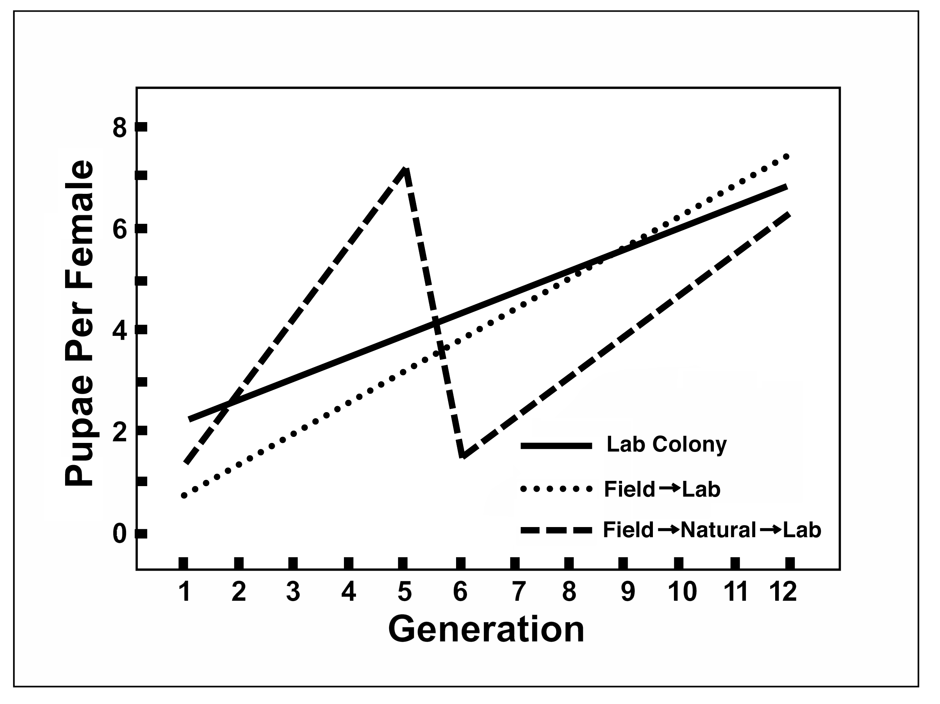
Changing Procedures: Mediterranean Fruit Fly

Slide 27
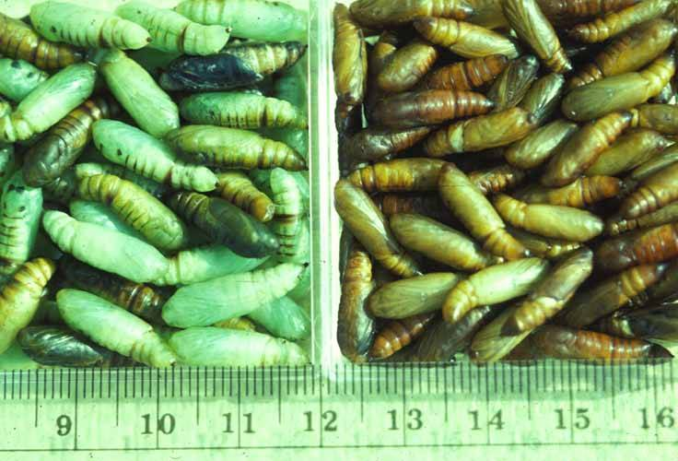
Soybean Looper vs. Cabbage Looper

Slide 28
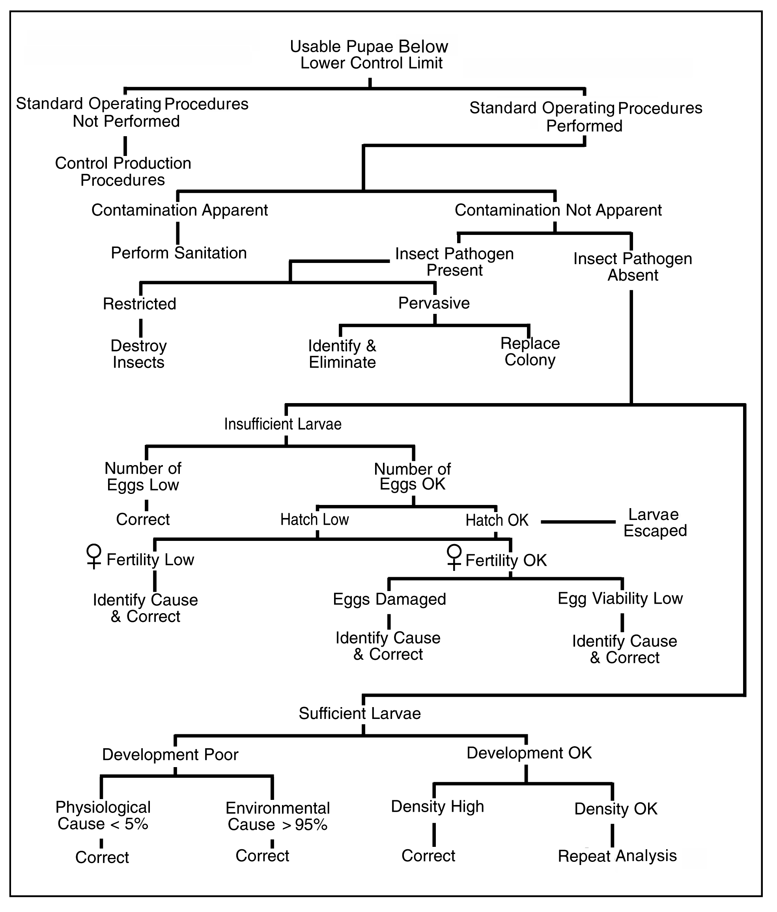
Diagnose Problems

Slide 29
Strain Modification
Maintain “natural” colony- Low productivity, high variability, expensive
Select in insectary- High productivity, uniformity, consistency, bottlenecks
Infuse from field- Short term recovery, hybridize?
Hybridize insectary and field populations- Crosses, new strains
Replace colony- New strain, adapt to insectary, low initial productivity

Slide 30
III. Monitoring Insect Quality
Quality Control Criteria and Standardized Tests
Sampling for Consistent Quality

Slide 31
Quality Control Criteria and Standardized Tests
Quantity- Number of required stage
Rate of Development- Synchronization
Viability- Emergence, sex ratio
Size- Weight or measurements
Fecundity- Oviposition and egg hatch
Adult Behavior- Flight, longevity
Field Performance- Achieve purpose

Slide 32
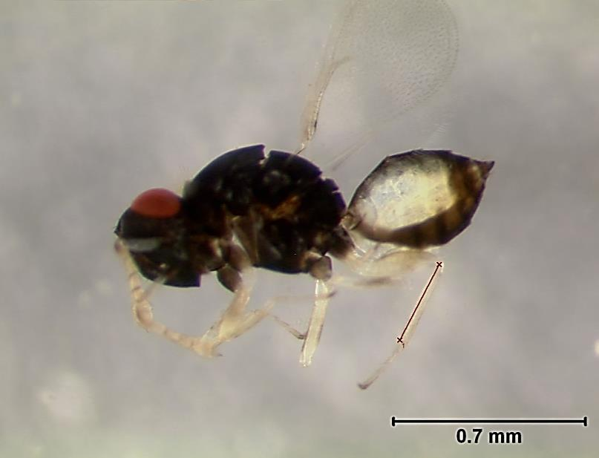
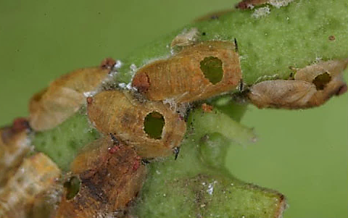
Tamarixia radiata Hind Tibia Length and Parasitism on Diphorina citri Nymphs
Hind tibia
Anonymous, UF

Slide 33
Tamarixia radiata Hind Tibia Length
Minimum, maximum and mean hind tibia length of T. radiata that were developing on different Asian citrus psyllid host nymph instars ^{1, 2}
Host instar | Females |  |  | Males
 | Min | Max | x̄±SD (n) | Min | Max | x̄±SD (n)
Third | --- | --- | ---------- | 0.16 | 0.21 | 0.20±0.02 (13) c
Fourth | 0.23 | 0.27 | 0.25±0.02 (6) b | 0.21 | 0.27 | 0.24±0.02 (55) b
Fifth | 0.27 | 0.34 | 0.31±0.02 (75) a | 0.27 | 0.33 | 0.29±0.02 (40) a
¹ Comparison of means within a given instar were not significantly different between sexes (Tukey’s HSD, α =0.05).
Chris Kerr
Notes:
S:R and size effects

Slide 34
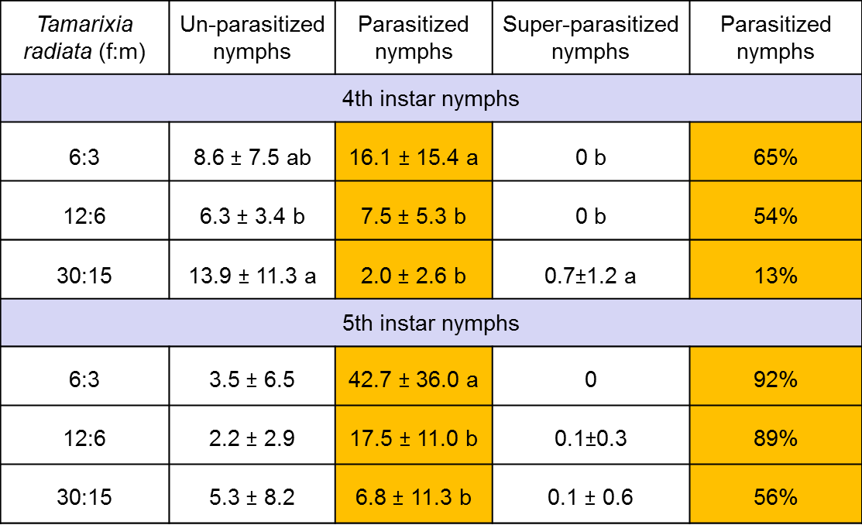
Tamarixia radiata and
Diaphorina citri Ratios
Chris Kerr

Slide 35
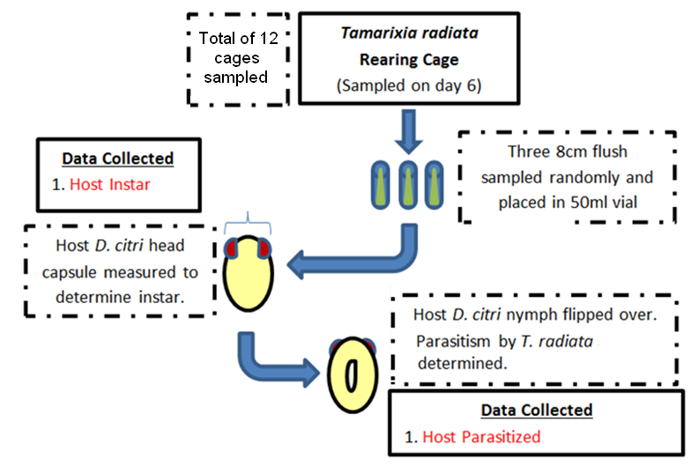
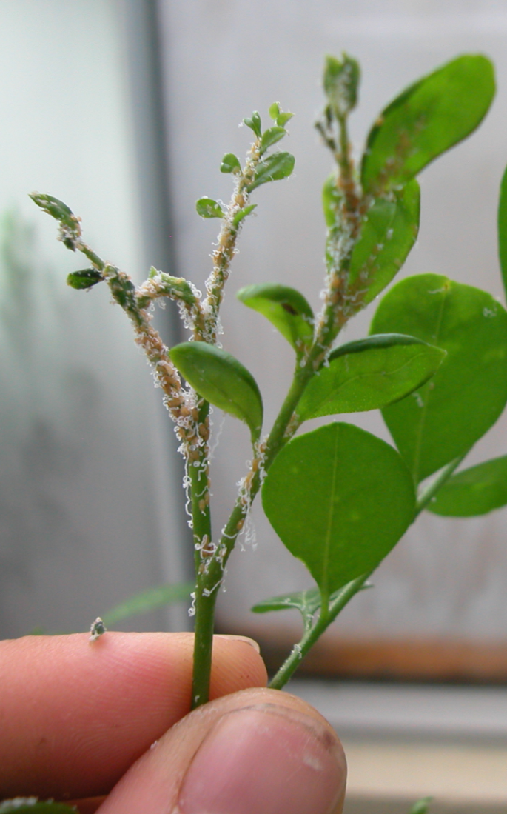
Level of Tamarixia radiata Parasitism on Diphorina citri
Chris Kerr

Slide 36
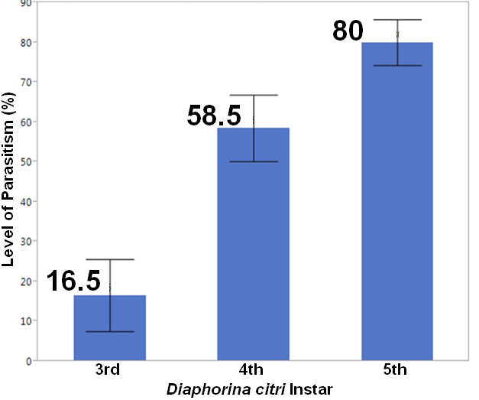
Level of Tamarixia radiata Parasitism on Diphorina citri
Chris Kerr
Notes:
Level of parasitism

Slide 37
Sampling for Consistent Quality
Count = Measurement = N
Mean = Sum/Number of Counts = X
Variance = Sum of (N – X)² / n-1 = ²
Standard Deviation = Square Root of ² = SD

Slide 38
Number of Cabbage Looper Pupae Per Rearing Container
Shelf
Container | 1 |  |  |  | 2 | 3 | 4 | 5 | 6
1 | 175 | 157.6 | 17.4 | 302.76 | 190 | 190 | 191 | 180 | 142
2 | 167 | 157.6 | 9.4 | 88.36 | 191 | 191 | 190 | 180 | 176
3 | 144 | 157.6 | -13.6 | 184.96 | 191 | 190 | 192 | 189 | 156
4 | 166 | 157.6 | 8.4 | 70.56 | 191 | 192 | 190 | 176 | 138
5 | 136 | 157.6 | -21.6 | 466.56 | 190 | 191 | 190 | 174 | 181
Average | 157.6 |  |  |  | 190.6 | 190.8 | 190.6 | 179.8 | 158.6
Sum of Squares |  |  |  | 1,113.2
Variance |  |  |  | 278.3
Standard Deviation |  |  |  | 16.7 | 0.5 | 0.8 | 0.9 | 5.8 | 19.4
Shelf 1 is lowest

Slide 39
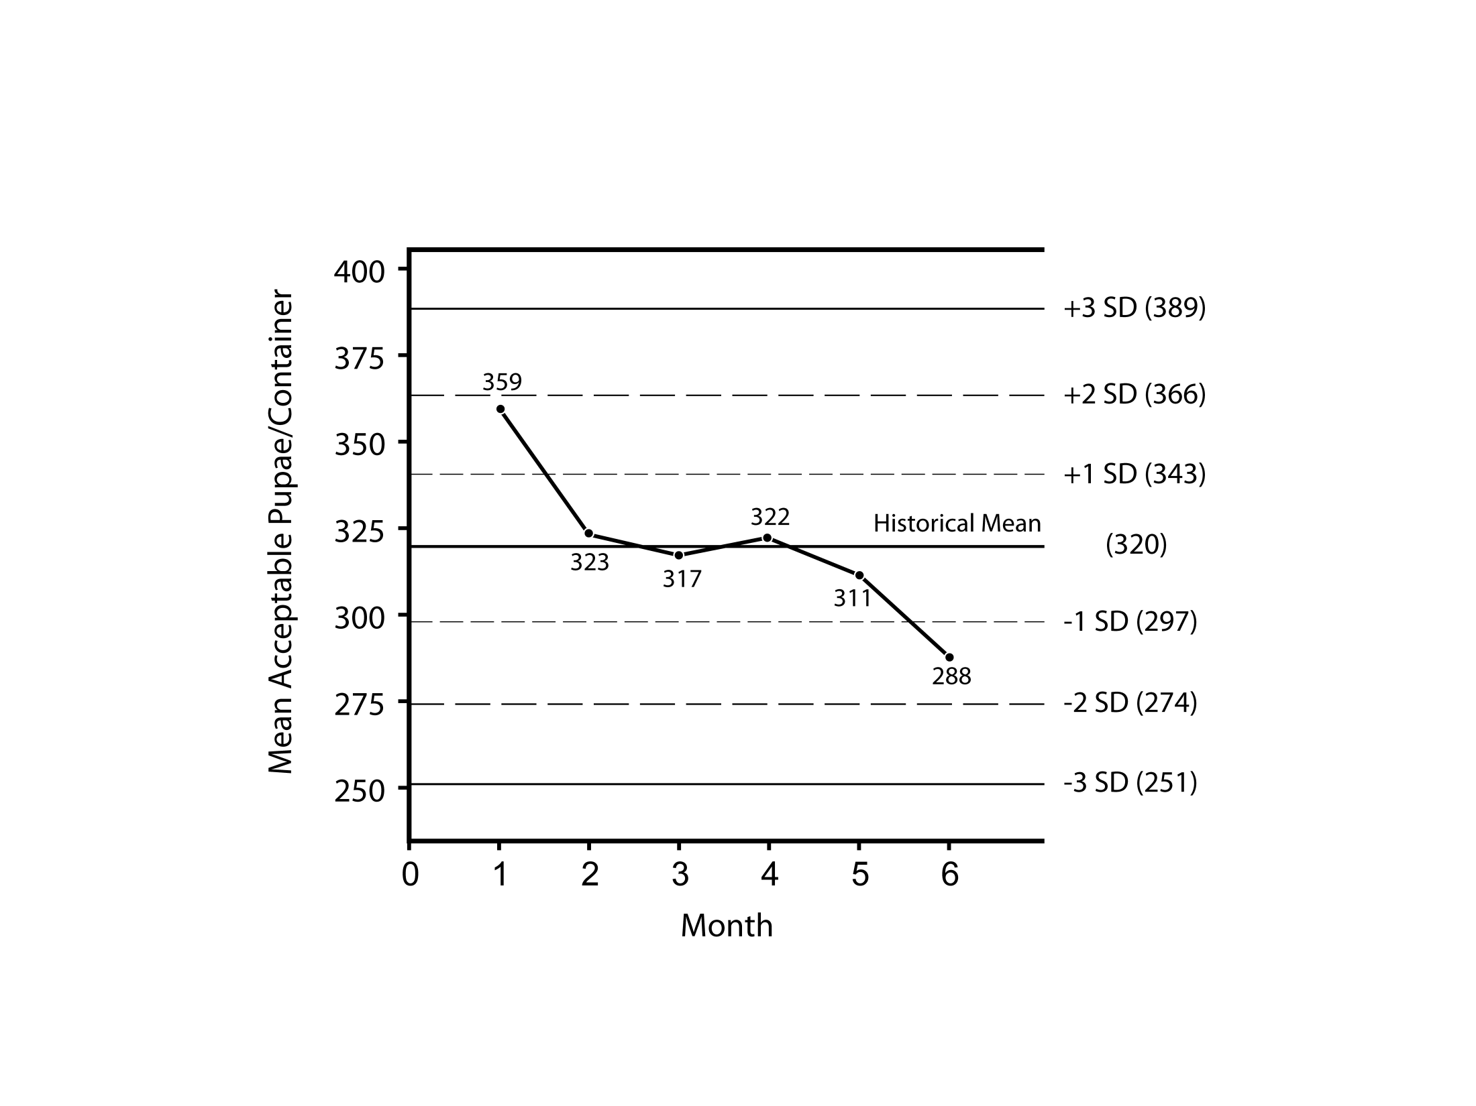
Quality Control Charts

Slide 40
Standardized QC Tests
Joop van Lenteren (2003), IOBC- Guidelines for quality control of commercially produced natural enemies, 30 species
Rose Buitenhuis (2014), Grower guide to quality assurance of biocontrol products, 22 species
Custom, develop your own, site-specific

Slide 41


For more information or a copy of this presentation please visit:
http://ipm.ifas.ufl.edu

